Slide 1
Proposition 98 Spending Highlights - 2016-17
April, 2016
Jeff Bell
Program Budget Manager

Slide 2
Proposition 98 has grown 51%
over the last 6 years.
Dollars in Billions

Slide 3
Proposition 98 Debt Reduced by Over $24 Billion
3
$27.5 B
$3.4 B
2011-12 2016-17

Slide 4
Deferrals Eliminated in 2014-15
Dollars in Millions

Slide 5
Proposition 98 K-12 per pupil funding
has grown 51% over the last six years.
Dollars in Thousands
$3,600
per pupil
increase

Slide 6
Base
LCFF Projected to be 95% Implemented in 2016-17
Dollars in Billions
Target
GAP
Funding

Slide 7
General Fund Expenditure by Agency
2011-12
2016-17

Slide 8
General Fund Expenditure by Agency
2007-08
2016-17

Slide 9
General Fund Expenditure by Agency
2005-06
2016-17

Slide 10
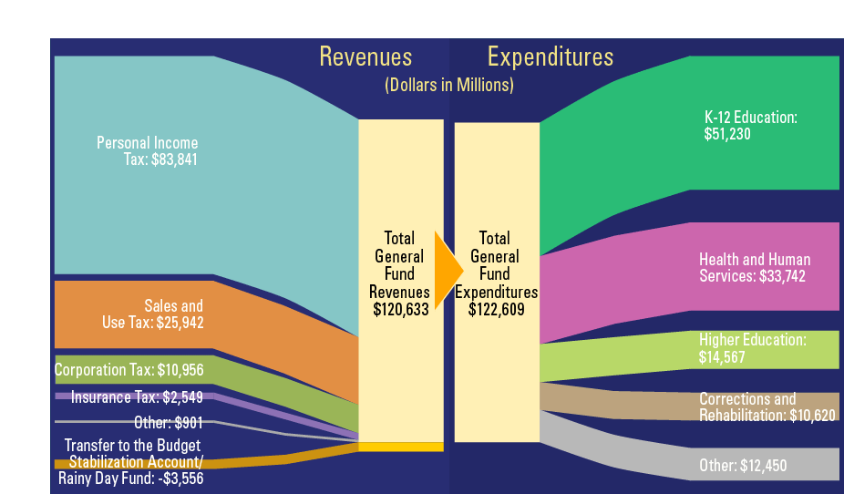
2016-17 General Fund Revenues vs. Expenditures

Slide 11
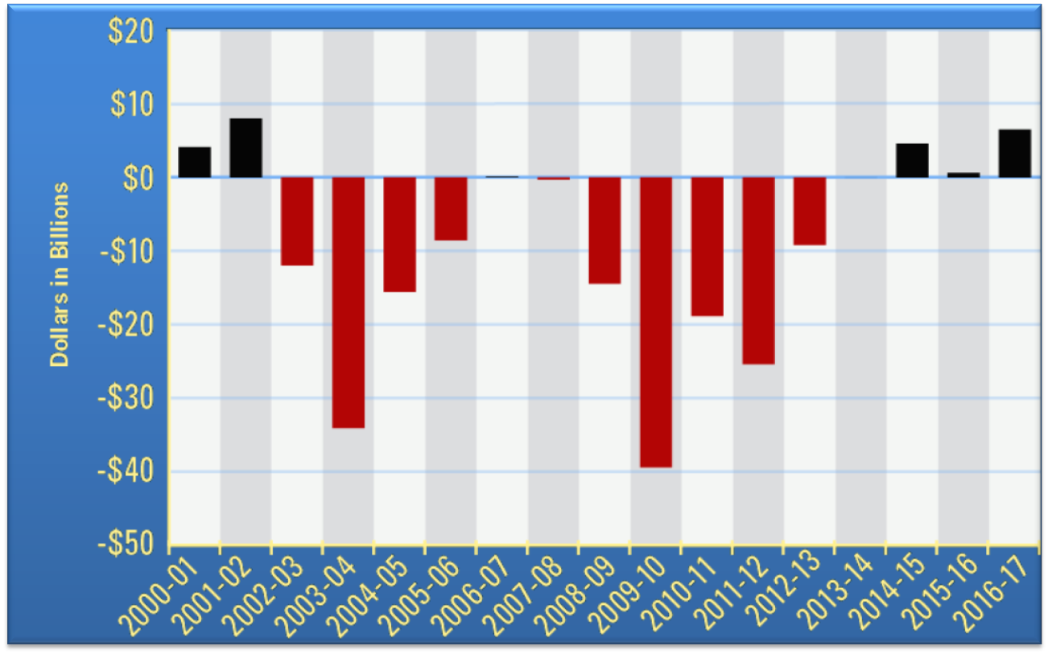
Balanced Budgets Have Been Quickly Followed by Huge Deficits

Slide 12
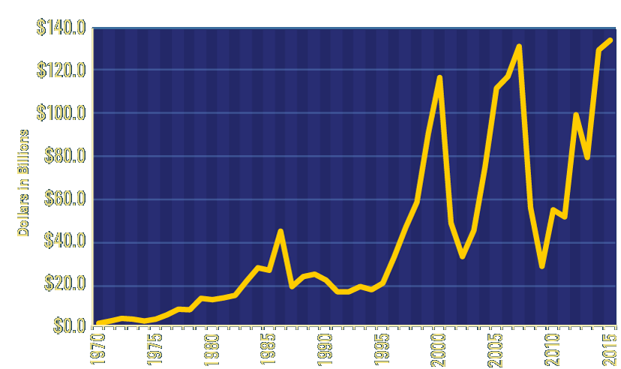
Unpredictable Capital Gains

Slide 13
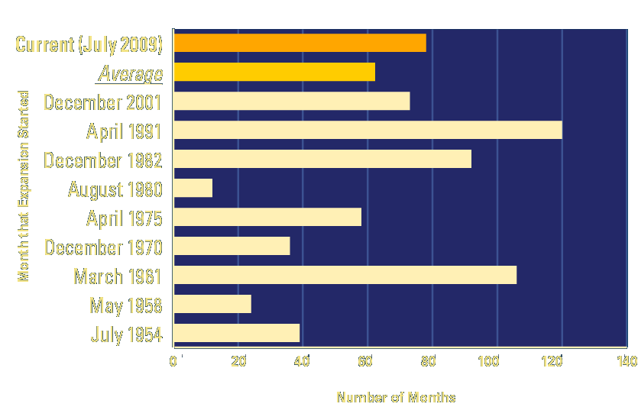
Current Recovery Already Two Years Longer Than Average

Slide 14
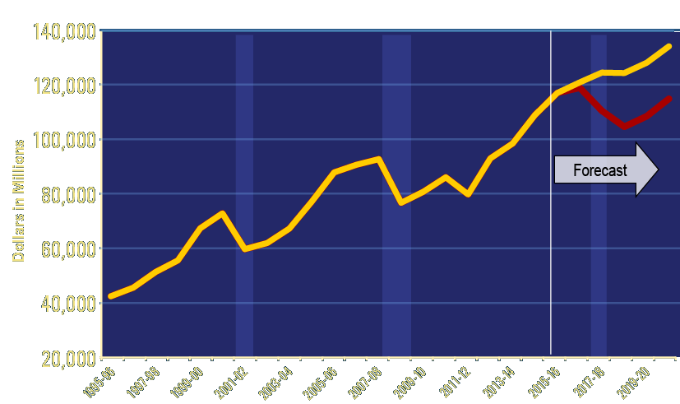
Recession Could Cause Loss of $55 Billion in Revenues by 2019-20

Slide 15
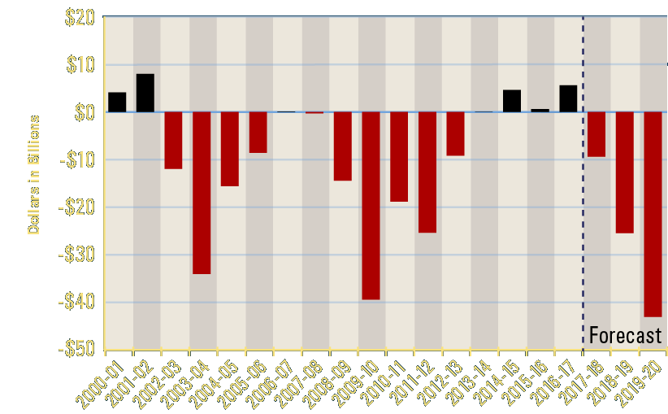
More Permanent Spending, Combined with Recession, Would Be Devastating

Slide 16
Thank You!
April, 2016

